Slide 1
Water Quality in California
Team 11
Evan Green, Jinbum Park, Xiaotian Wang, Bing Liang

Slide 2
Overview
Problem Statement
Data Sources and Tools
Graphs and Relationships
Analysis

Slide 3
Problem:
Is it more likely to have lower-quality water in a more densely populated area?

Slide 4
Water Quality – How It Was Measured
Dissolved Oxygen
Some species of marine life require higher amounts of DO
Temperature
Rate of photosynthesis, sensitivity of organisms, metabolic rates
Turbidity
Amount of suspended particles in the water (cloudiness)
pH
How acidic or basic the water is by measuring the hydrogen ion concentration
Notes:
make sure to note where the bodies of water are found - streams, rivers?

Slide 5
Data Sources
https://ceden.waterboards.ca.gov
Excessive, unimportant data had to be trimmed and filtered out
Water Quality
Population - http://www.dof.ca.gov
Land Area- https://www.census.gov
Merging multiple data sets together
Data trimming and cleaning
County Population Density

Slide 6
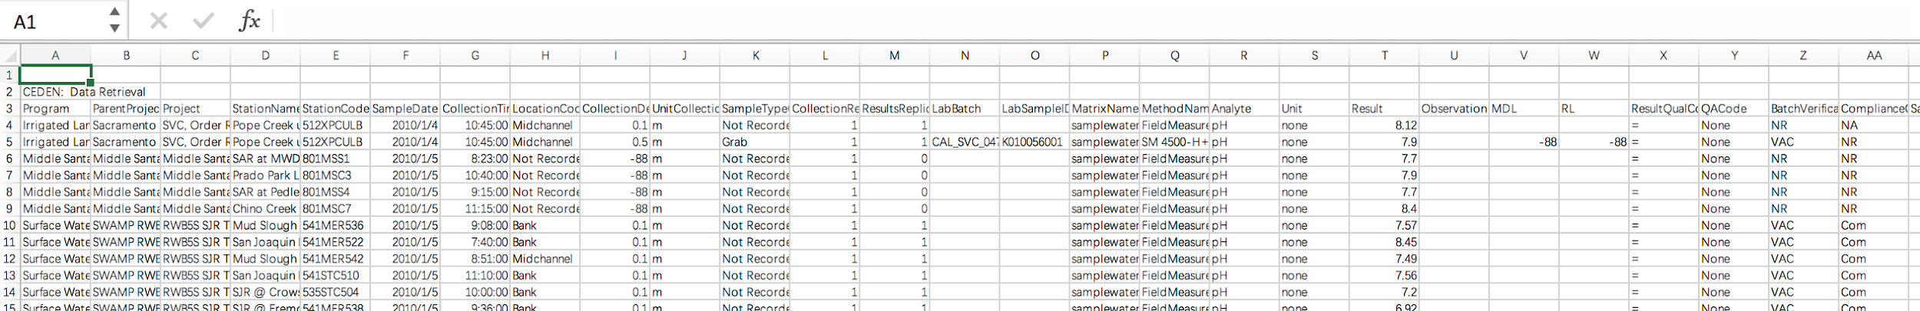
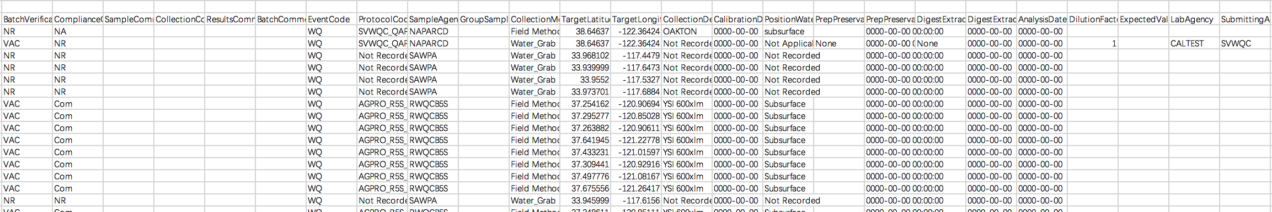
Our raw data
Notes:
Like what we showed here, the size of each dataset has almost fifty thousand times thirty that huge. We need to pick up useful information for our project.

Slide 7
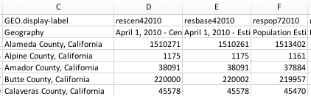
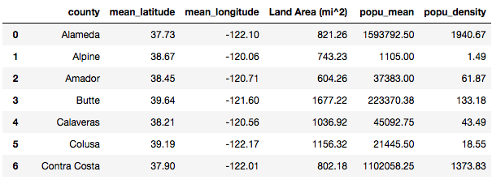
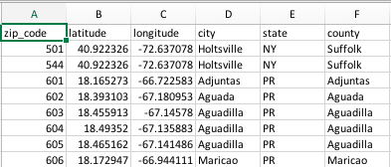
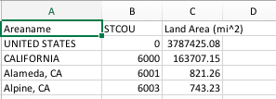
Data Preprocessing county data
County population data
County data
County zip code data
County land area data

Slide 8
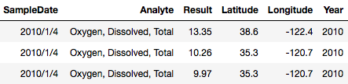
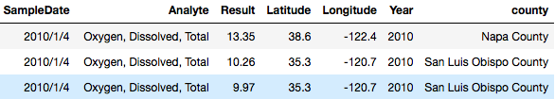
Data Preprocessing water quality indicator data
Raw data
Truncate coordinates
to 1 decimal:
find county for all record (package: geopy) :

Slide 9
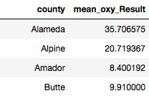
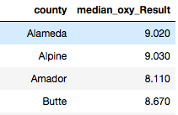
Data Preprocessing water quality indicator data
By mean:
By median:
Group all records belong to the same county:

Slide 10
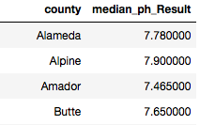
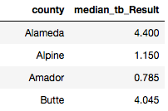
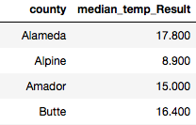
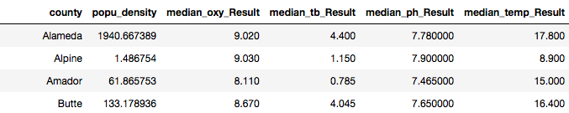
Data Preprocessing combine county and water quality data
Water quality data:
County data:
Combined data:

Slide 11
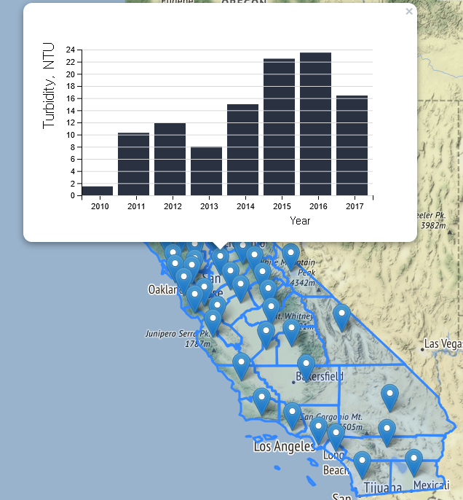
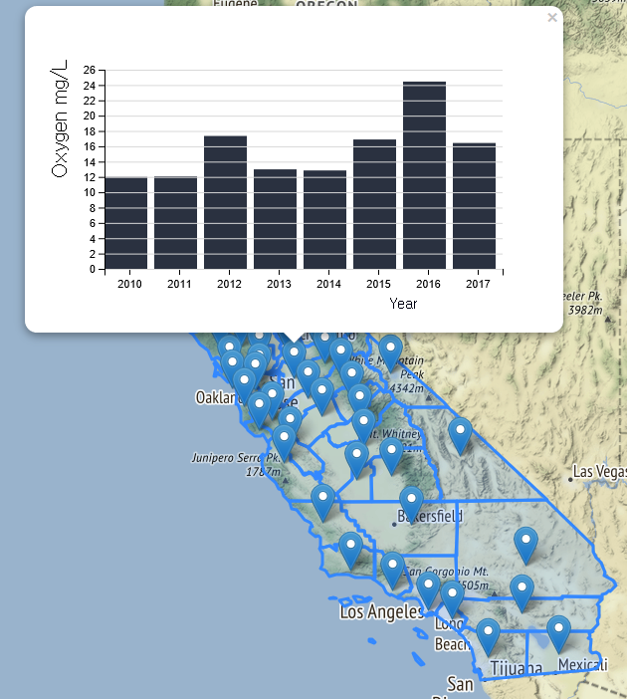
Water Quality Data - Annual median ( Turbidity, Oxygen ) data of each county

Slide 12
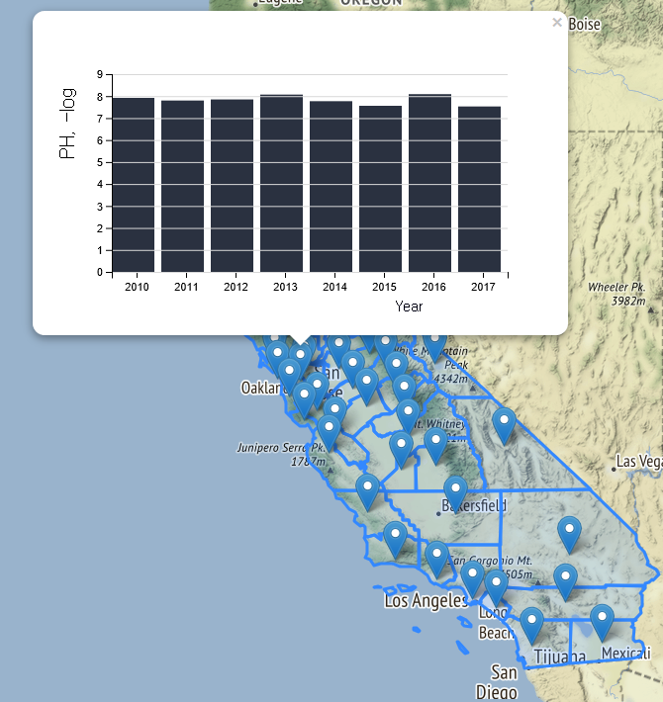
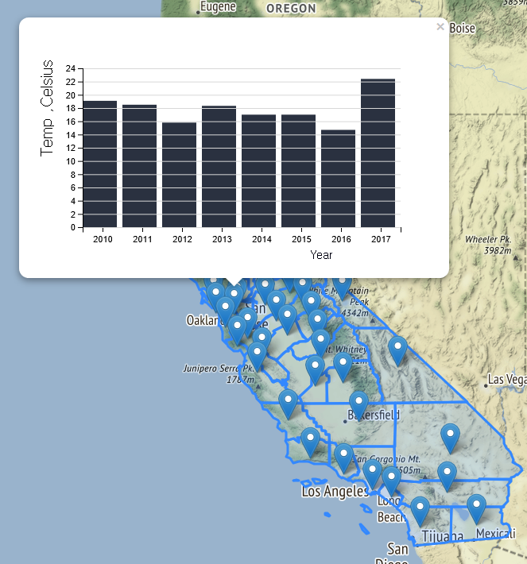
Water Quality Data - Annual median ( ph, Temp ) data of each county

Slide 13
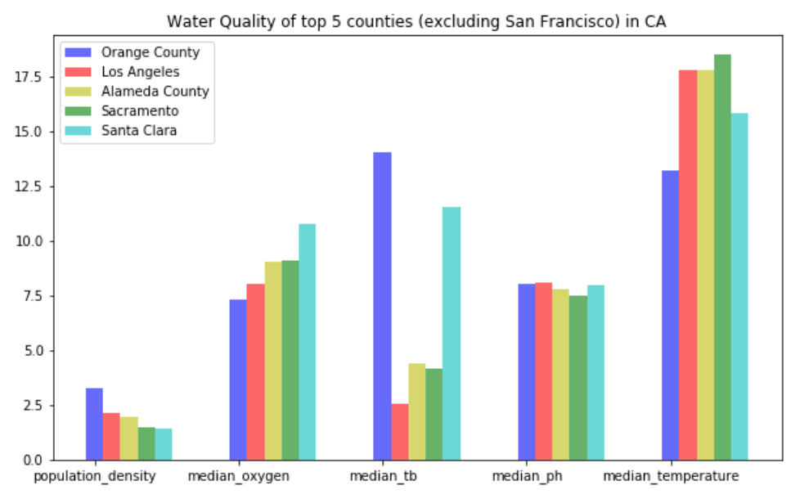
Water Quality of Top 5 population density county

Slide 14
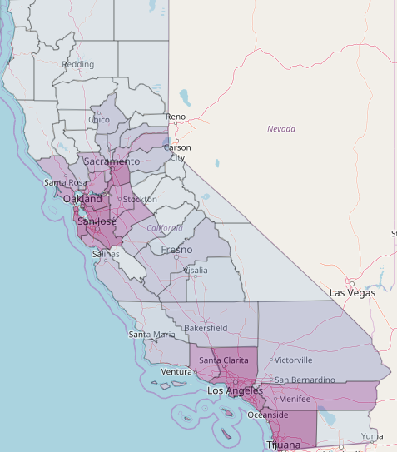
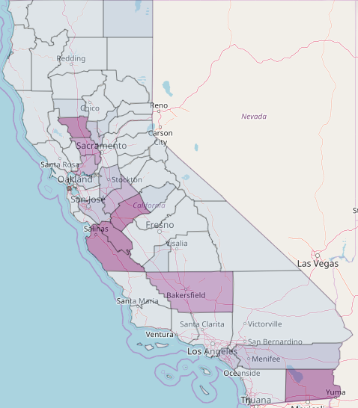
Population Density by County
Turbidity by County

Slide 15
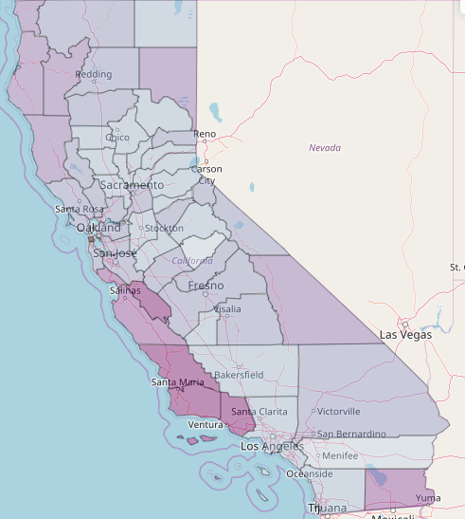
Population Density by County
Dissolved Oxygen by County

Slide 16
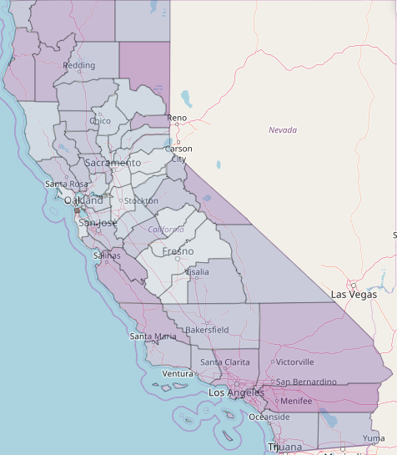
Population Density by County
pH by County

Slide 17
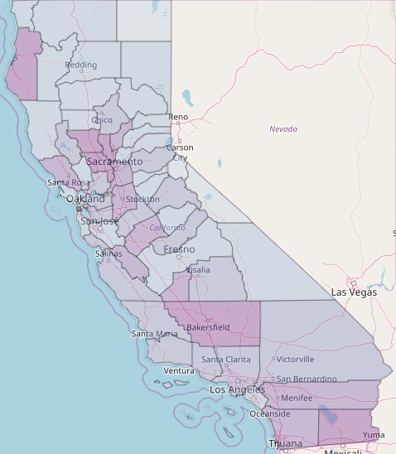
Population Density by County
Water Temperature by County

Slide 18
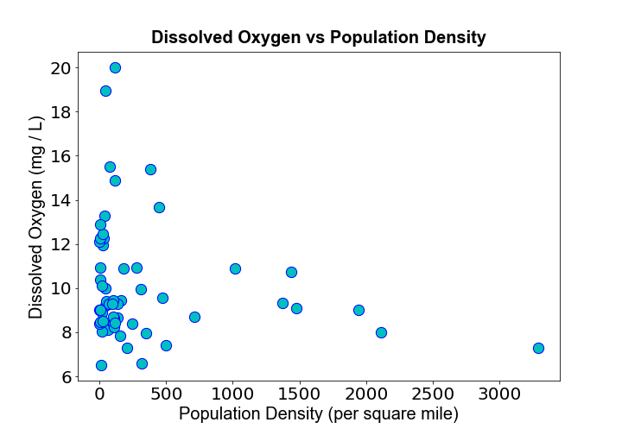
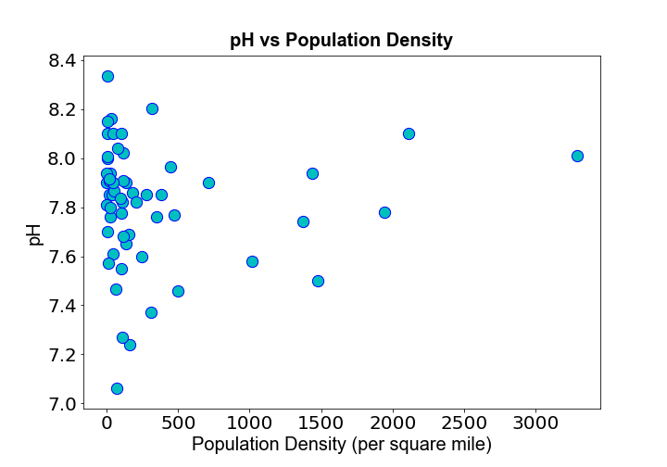
Scatter points:
Dissolved oxygen and pH versus population density
Correlation: -0.192
Correlation: 0.036

Slide 19
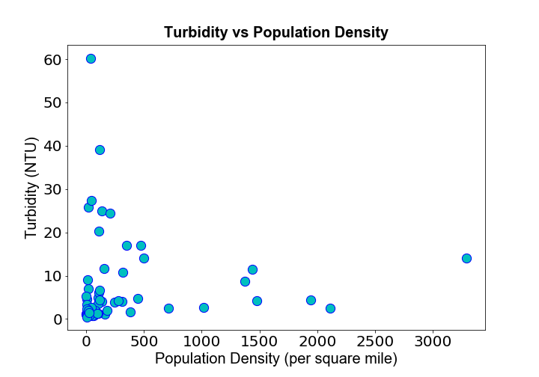
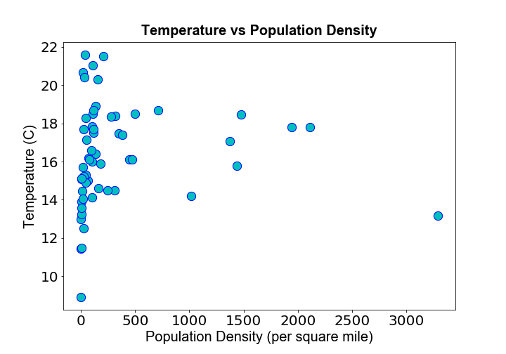
Scatter points:
Turbidity and temperature versus population density
Correlation: 0.011
Correlation: 0.036

Slide 20
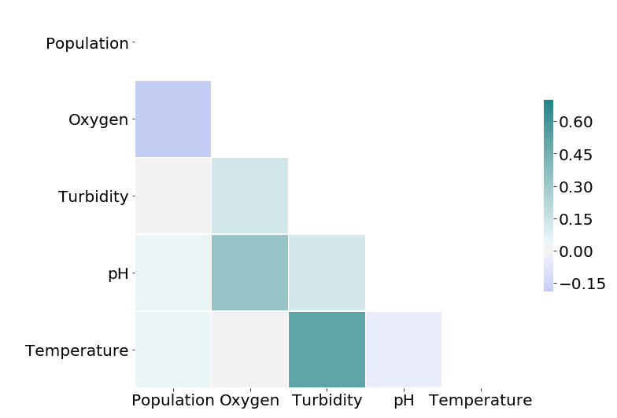
Correlation
1. Population density have slight negative correlation with dissolved oxygen.
2. Population density has very little correlation with pH, turbidity and temperature.
3. pH and oxygen, temperature and turbidity have a relatively strong correlation.

Slide 21
Summary
Our work:
Group all water quality records by their median in every county.
Map water quality data for every county on the map.
Analyze correlation between population and water quality indicators.
Conclusion:
Population density has a slight negative correlation with dissolved oxygen
In terms of dissolved oxygen, it is likely to have worse water quality in densely populated areas.
Population density has very little correlation with pH, turbidity and temperature.

